Slide 1


Progress and Controversies in
Gynecologic Oncology, Barcelona 2014
Interactive case discussion:
Platinum-sensitive recurrent ovarian cancer
Discussant:
Prof Dr Andreas du Bois, MD, PhD
Direktor der Klinik für Gynäkologie & Gynäkologische Onkologie
Kliniken Essen Mitte
Henricistrasse 92
45136 Essen
Germany

Slide 2
Case Presentation
65-year-old patient with high-grade serous ovarian cancer
stage FIGO IIIC, pT3c, pN0 (8/43 Ln), 1st diagnosis 12/2012
12/2012 Laparotomy with TAH + BSO + partial pelvic peritonectomy,
infragastric omentectomy, debulking right diaphragm and lig.
facliforme, debulking of enlarged pelvic + para-aortic lymph nodes.
residual tumor = 0.5 cm (bowel serosa small and large intestine)
1-4/2013 6 x Carboplatin / Paclitaxel / Bevacizumab ->
Bevacizumab single agent as maintenance therapy until 5/2014
(standard arm of AGO-OVAR 17; ENGOT-ov15; BOOST)
8/2014 16 months after last platinum and 3 months after last bevacizumab
patient presented with some cough and she felt tired,
gyn evaluation showed some ascites, but no pelvic tumor,
CA 125 increased from normal to 185 U/ml
8/2014 Diagnostic work-up
BSO, bilateral salpingo-oophorectomy; LNE, lymphadenectomy; TAH, total abdominal hysterectomy

Slide 3
Image not available

Slide 4

What would you recommend?
Re-operation aiming at complete surgical debulking, followed by chemotherapy
Start with systemic therapy

Slide 5
What would you recommend?
14.7%
85.3%
Re-operation aiming at complete surgical debulking, followed by chemotherapy
Start with systemic therapy

Slide 6
Image not available

Slide 7


1. Re-operation aiming at complete surgical debulking (eventually followed by chemotherapy)
..but would not suggest
to do so,
Why?
Reasons not to operate:
Initially incomplete resection due to peritoneal carcinomatosis
-> Now, again signs for peritoneal carcinomatosis (ascites) reducing the
probability of complete resection (and incomplete op without benefit)
2. Extraperitoneal spread (pleural effusion and mediastinal lymphnodes, and more?)
Symptoms rather associated with effusions than with resectable tumor
-> early start of systemic treatment preferable?

Slide 8
DESKTOP III (AGO – OVAR OP.4; ENGOT-ov20)
Recurrent invasive
ovarian, tubal, or
peritoneal cancer
Patient fit for extended
abdominal surgery
and for platinum-
based combination
1 prior chemothx
until >6 months;
max. 1 prior non-
chemo maintenance
therapy until >4 wks;
no prior abdominal or
pelvic radiotherapy
Centre pre-defines
chemotherapy regimen
(for both arms)
Cytoreductive
Surgery with
max. effort for
complete
resection
Platinum-based
combination therapy
strongly recommended
R
n = 408
Immediate
Platinum-based
combination therapy
strongly recommended
No OP
OP
Allowed
Endpoints: OS, PFS, Tox, QoL
Strata: centre, age (+/-65)
Recommended regimen: carbo-pegylated liposomal doxorubicin (PLD)
carbo-gemcitabine +/- bevacizumab
carbo-paclitaxel
any other platinum-containing regimen within studies

Slide 9
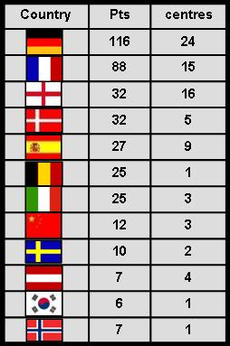
The DESKTOP League

Slide 10





2. Start with systemic therapy (with or w/o prior surgery)
… but which regimen?
Ferrari aka Carbo-PLD
(CALYPSO; AGO-OVAR 2.9)
Lamborghini aka Carbo-Tax
(ICON4; AGO-OVAR 2.2)
Porsche aka Carbo-Gem
(AGO-OVAR 2.5)
Porsche 911 Turbo S Cabriolet
aka Carbo-Gem + Bev (OCEANS)
Porsche plus Trailer
aka Platinum -> Olaparib

Slide 11
Which strategy would you recommend? (either with or w/o prior surgery)
Platinum combination
Re-induction with carboplatin + paclitaxel
Platinum re-induction with another partner (PLD or Gem)
Platinum combination plus bevacizumab
Best platinum regimen followed by olaparib (PARPi)

Slide 12
Which strategy would you recommend? (either with or w/o prior surgery)
Platinum combination
Re-induction with carboplatin + paclitaxel
Platinum re-induction with another partner (PLD or Gem)
Platinum combination plus bevacizumab
Best platinum regimen followed by olaparib (PARPi)
40.8%
34.2%
25%

Slide 13
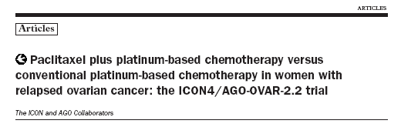

No. 1: Platinum combination
R A N D O M I Z A T I O N
Study arm
Paclitaxel 175-185 mg/m² (3h)
+
Carboplatin AUC 5-6
or Cisplatin (10%)
802 patients
n = 392
Relapsed OC >6 / >12 months after platinum
1 prior regimen with
platinum (Italy)
or
platinum-paclitaxel
(Germany)
Standard
Platin without paclitaxel
Carboplatin mono (71%)
Cisplatin mono (2%)
Other platin regimens (27%)
or
at least 1 prior platinum
regimen (UK)
n = 410
The ICON and AGO Collaborators.
Parmar MK, et al. Lancet. 2003;361(9375):2099-2106.

Slide 14
ICON4/AGO-OVAR 2.2 Progression-Free and Overall Survival
The ICON and AGO Collaborators.
Parmar MK, et al. Lancet. 2003;361(9375):2099-2106.

Slide 15
No. 1: Platinum combination
AGO-OVAR 2.5– NCIC CTG – EORTC GCG
Recurrence >6 months after
first-line therapy
At least evaluable disease
Strata:
Platinum-free interval (6-12 months, >12 months)
First-line therapy (platinum +/- paclitaxel)
-> 71% had prior taxane
(closer to SoA today)
Measurable vs evaluable disease
R A N D O M I Z
A
T
I
O
N
Gemcitabine 1000 mg/m² d 1+8
Carboplatin AUC 4 d 1
q 21 x 6 (-10)
Carboplatin AUC 5 d 1
q 21 x 6 (-10)
SoA, state of the art
Pfisterer J, et al. J Clin Oncol. 2006;24(29):4699-4707.
Notes:
15

Slide 16
AGO-OVAR 2.5:
Progression-Free Survival (Significant)
— Carboplatin
— Gemcitabine + carboplatin
Not powered for survival
Explorative analysis: no difference, median 18 months vs 17.3 months, HR 0.96, P = .735
Pfisterer J, et al. J Clin Oncol. 2006;24(29):4699-4707.

Slide 17
CALYPSO / AGO-OVAR 2.9
No. 1: Platinum combination
International, Intergroup, Open-Label, Randomized Phase III Study
Ovarian cancer in late relapse (>6 months) after first-line or second-line platinum and taxane therapy
(100% with prior taxane)
Experimental arm: CD
PLD 30 mg/m² IV d 1
Carboplatin AUC 5 d 1
R
A
N
D
O
M
I
Z
E
Q 28 days x 6 courses*
Control arm: TC
Paclitaxel 175 mg/m² IV d 1
Carboplatin AUC 5 d 1
Strata:
Therapy-free interval (6-12 months vs >12 months)
Measurable disease (yes vs no)
Center
Q 21 days x 6 courses*
*Or progression in patients with SD or PR
Pujade-Lauraine E, et al. J Clin Oncol. 2010;28(20):3323-3329.

Slide 18
Progression-Free Survival (ITT)
Survival not primary endpoint
However, no difference, median 30.7 months vs 33 months, HR 0.99, P = .94
ITT, intent to treat
Pujade-Lauraine E, et al. J Clin Oncol. 2010;28(20):3323-3329.Wagner U, et al. Br J Cancer. 2012;107(4):588-591.

Slide 19
Platinum Combinations in PT-Sensitive ROC: How to Incorporate All the Available Data?
Paclitaxel + Carboplatin | Gemcitabine + Carboplatin | PLD + Carboplatin
PFS TC > C OS TC > C | PFS CG > C OS ? | PFS CC > TC OS CC = TC
Schedule: d1 q 3 w | Schedule: d1+8 q 3 w | Schedule: d1 q 4 w
Neurotoxicity | Hematotoxicity | Skin/mucosa
Alopecia 86% | Alopecia 15% | Alopecia 7%
QoL identical | QoL identical | QoL identical
superior
not compared
Notes:
19

Slide 20

Answer to question No. 1: Platinum combinations
… and the golden apple goes to…
If I had to choose among the platinum combinations,
I would prefer carboplatin-PLD
(if not contraindicated by co-morbidity and if available)

Slide 21






OCEANS: Study Schema
No. 2: Carbo-Gem-Bev
Platinum-sensitive recurrent OC
Measurable disease
ECOG 0/1
No prior chemo for
recurrent OC
No prior Bev
(n = 484)
CG + PL
C AUC 4
G 1000 mg/m², d1 & 8
PL q3w until progression
C AUC 4
G 1000 mg/m², d1 & 8
CG + Bev
Bev 15 mg/kg q3w until progression
Strata:
Platinum-free interval (6-12 months vs >12 months)
Unsuccessful cytoreductive surgery for recurrent disease (yes vs no)
CG for 6 (up to 10) cycles
Bev, bevacizumab; PL, placebo; C, carboplatin; G, gemcitabine
Aghajanian C, et al. J Clin Oncol. 2012;30(17):2039-2045.
Notes:
Carbo/gem from AGO trial (identical dose and schedule), allowed up to 10 cycles in responding pts.
Bev continued until progression in contrast to GOG-0218 and ICON7.
All pts had measurable disease as defined by RECIST (older criteria).
Stratification by cytoreductive surgery was probably not necessary as all pts had measurable disease – driven by thoughts that treatment paradigm was changing in US
21

Slide 22
OCEANS: Efficacy PFS and OR
No. 2: Carbo-Gem-Bev
Aghajanian C, et al. J Clin Oncol. 2012;30(17):2039-2045.
Notes:
Carbo/gem from AGO trial (identical dose and schedule), allowed up to 10 cycles in responding pts.
Bev continued until progression in contrast to GOG-0218 and ICON7.
All pts had measurable disease as defined by RECIST (older criteria).
Stratification by cytoreductive surgery was probably not necessary as all pts had measurable disease – driven by thoughts that treatment paradigm was changing in US
22

Slide 23
OCEANS: Survival Analyses
No. 2: Carbo-Gem-Bev
¹
²
… again, neither survival benefit nor harm
.
1. Aghajanian C, et al. J Clin Oncol. 2011;29(suppl): Abstract LBA5007; 2. Aghajanian C, et al. Ann Oncol. 2012:23(Suppl 9): Abstract 9670.
Notes:
Carbo/gem from AGO trial (identical dose and schedule), allowed up to 10 cycles in responding pts.
Bev continued until progression in contrast to GOG-0218 and ICON7.
All pts had measurable disease as defined by RECIST (older criteria).
Stratification by cytoreductive surgery was probably not necessary as all pts had measurable disease – driven by thoughts that treatment paradigm was changing in US
23

Slide 24
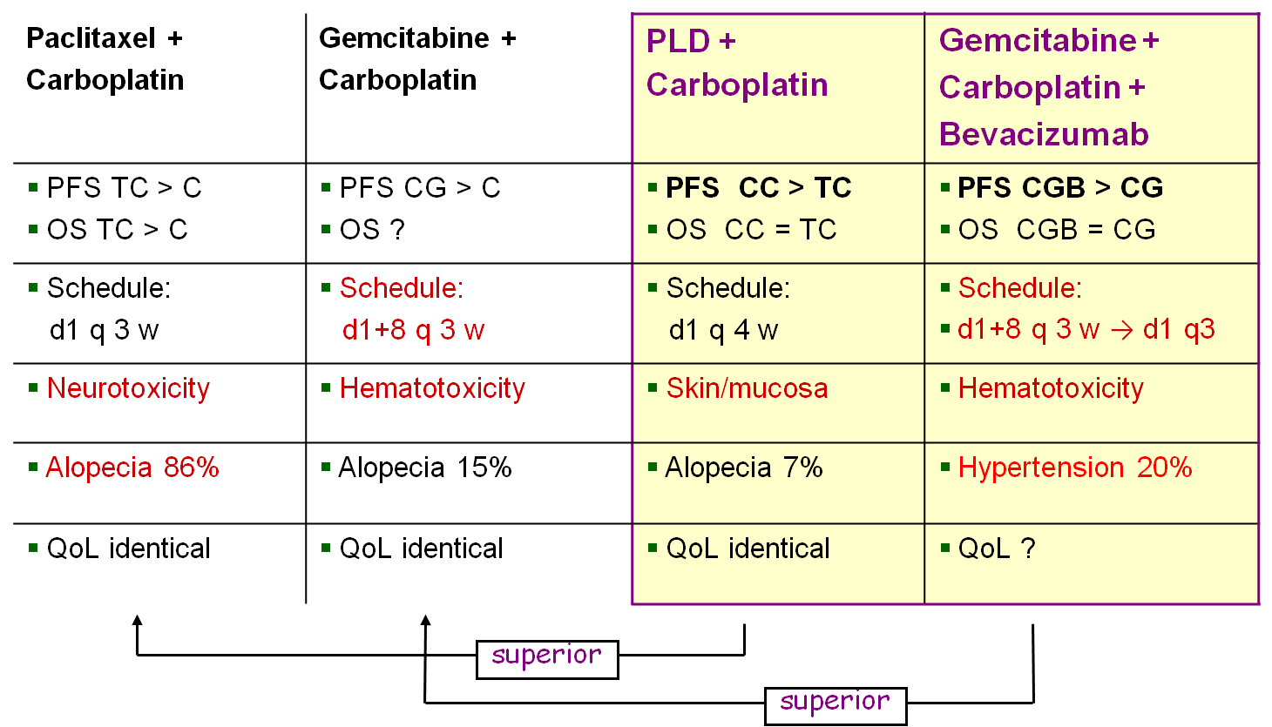
No. 1 and 2: Carbo-PLD or Carbo-Gem-Bev ?
Problem: Bevacizumab is only registered for one line – in Europe;
either first-line or platinum-sensitive relapse or platinum-resistant relapse…. and this pat. had already received bev ?!
Notes:
24

Slide 25


In problem?
Call AGO & friends

Slide 26







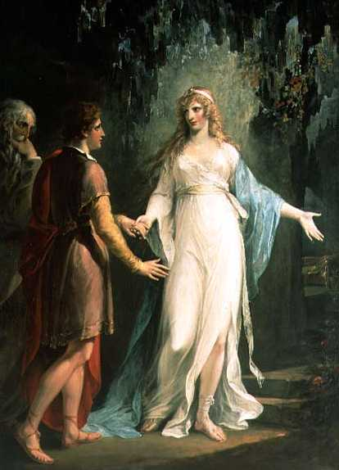
AGO-OVAR 2.21
ENGOT ov18
One possible solution (app. until summer 2015):
OCEANS
vs
Calypso
+ Bev
Bevacizumab 15 mg/kg q3w until PD
Gemcitabine 1000 mg/m² d1 and 8
1:1
Carboplatin AUC 4 d1 q3w
R
Bevacizumab 10 mg/kg q2w
Bevacizumab 15 mg/kg q3w until PD
N = 870
Pegylated Liposomal Doxorubicin 30 mg/m² d1
Carboplatin AUC 5 d1 q4w
Stratification Factor
Platinum-free interval (6-12 months vs >12 months)
In case of debulking surgery for recurrence: residual tumor (yes vs no) In case of no debulking surgery for recurrence: all pts categorized to residual tumor = yes
Prior anti-angiogenic treatment (yes vs no)
Study group
I could offer study participation: ENGOT ov18 or … in some countries ENGOT-ov17

Slide 27




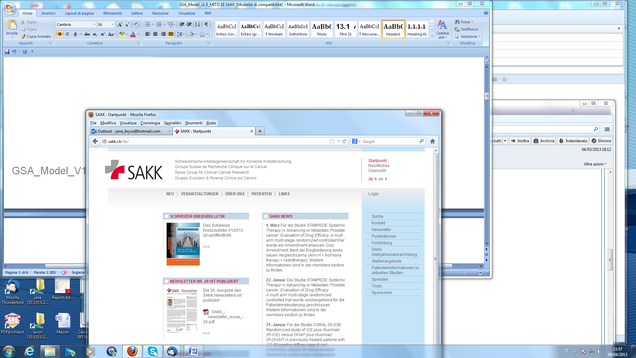



ENGOT Ov-17 Trial
MITO 16b; MANGO-OV2b
Study Design
CBDCA AUC5 + PAC 175 mg/m2 q3w
or
CBDCA AUC4, d1 + GEM 1000mg /m2, d1&8 q3w
or
CBDCA AUC5+PLD 30mg/m2 q4w
Ovarian Ca
Platinum-sensitive
Previous Bevacizumab
ECOG 0-2
Samples for transl. res.
No Bev contraindications
R
CBDCA AUC5 + PAC 175 mg/m2 q3w
Plus bevacizumab** 15mg/kg q3w
or
CBDCA AUC4, d1 + GEM 1000mg /m2, d1&8 q3w
Plus bevacizumab 15mg/kg q3w
or
CBDCA AUC5+PLD 30mg/m2 q4w
Plus bevacizumab 10mg/kg q2w
= Bevacizumab

Slide 28
No. 3: best platinum combination (Carbo-PLD) followed by Olaparib ?
Notes:
28

Slide 29
‘Study 19’ Randomized trial of maintenance olaparib in platinum-sensitive high-grade serous relapsed ovarian cancer
No. 3: best platinum combination followed by Olaparib ?
Study aim and design
265 patients
Patients:
Platinum-sensitive high-grade serous ovarian cancer
≥2 previous platinum regimens
Last chemotherapy was platinum-based, to which they had a maintained PR or CR prior to enrolment
Stable CA-125
Olaparib 400 mg po bid
Treatment until
disease
Progression
Randomized 1:1
Placebo po bid
Ledermann J, Harter P, et al.
N Engl J Med. 2012;366(15):1382-1392.
Notes:
29

Slide 30
Results: BRCA Testing
 |  | tBRCA
 |  | Mutated | Wild type* | Not available | TOTAL
gBRCA | Mutated | 71 | 3 | 22 | 96
 | Wild type* | 18 | 73 | 23
 | Not available | 22 | 22 | 11
 |  |  |  |  | 265
136 (51.3%) patients had a known deleterious BRCAm (BRCAm dataset)
118 (44.5%) patients were defined as BRCA1/2 wild type for this analysis
11 (4.2%) patients had neither a tumour nor a germline result available
The number of patients with a known BRCAm status increased from 97 (36.6%) to 254 (95.8%) out of 265
*Wild-type group includes patients with no known BRCAm or a mutation of unknown significance (a non-deleterious mutation)
Ledermann J, et al. Lancet Oncol. 2014;15(8):852–861.

Slide 31
PFS in Patients With a BRCA1/2 Mutation*
No. 3: best platinum combination (Carbo-PLD) followed by Olaparib ?
The greatest PFS benefit was observed in patients with a BRCA1/2 mutation (BRCAm)
 | BRCAm (n = 136)
 | Olaparib | Placebo
Events: total pts (%) | 26:74 (35.1) | 46:62 (74.2)
Median PFS, months | 11.2 | 4.3
 | HR = 0.18 95% CI (0.10, 0.31); P<.00001
1.0
0.9
0.8
0.7
0.6
Proportion of patients progression-free
0.5
0.4
0.3
0.2
Randomized treatment†
0.1
Olaparib BRCAm
Placebo BRCAm
0
0
3
6
9
12
15
Time from randomization (months)
Number at risk
Olaparib BRCAm
74
59
34
15
5
0
Placebo BRCAm
62
35
13
2
0
0
*Includes patients with germline and/or somatic mutations; †patients were treated until disease progression
Ledermann J, et al. Lancet Oncol. 2014;15(8):852–861.

Slide 32

Platinum-sensitive relapse
1st-line chemo + bevacizumab
BRCA
testing
Negative
Positive
Carbo-PLD
ENGOT study available?
yes
no
ENGOT ov18
Carbo-PLD
Response
no
yes
Plat-resistant
relapse
Olaparib
Carbo-Gem-Bev -> Bev
or
Carbo-PLD-Bev -> Bev

